Slide 1
Wallace Tree Multiplier using Kogge Stone Adder in VLSI circuit design
Group ID: BG17
Group Members: G A Rohit (CB.EN.U4ECE19115)
Sharmila S (CB.EN.U4ECE19148)

Slide 2
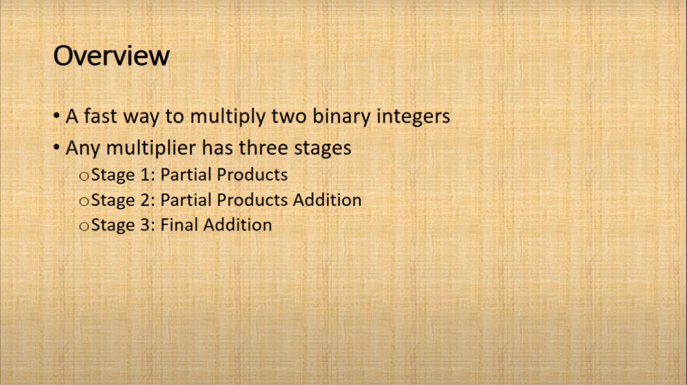
Traditional Wallace Tree multiplier

Slide 3
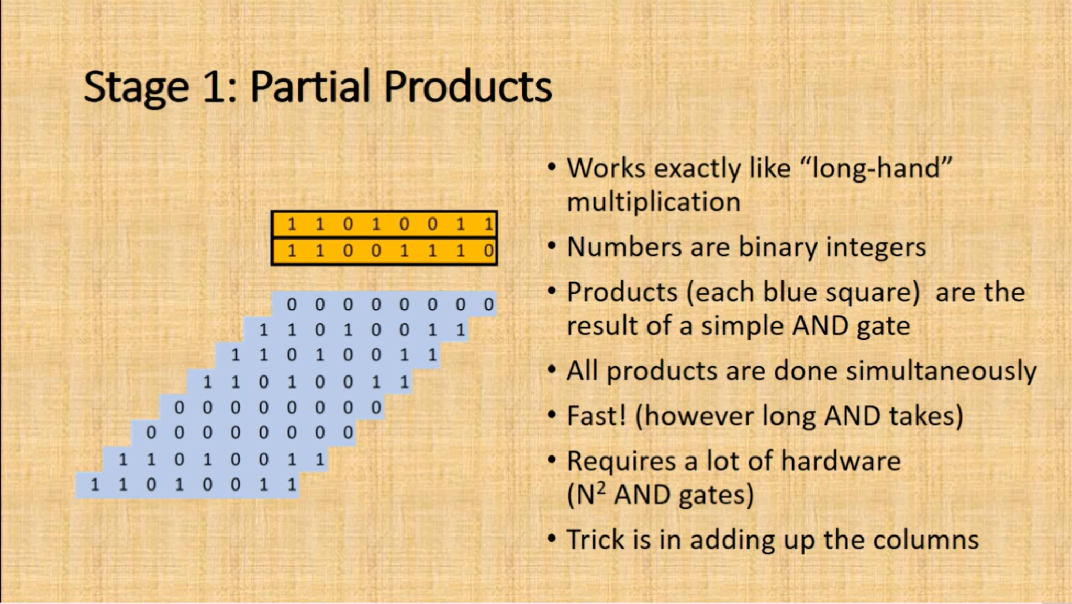

Slide 4
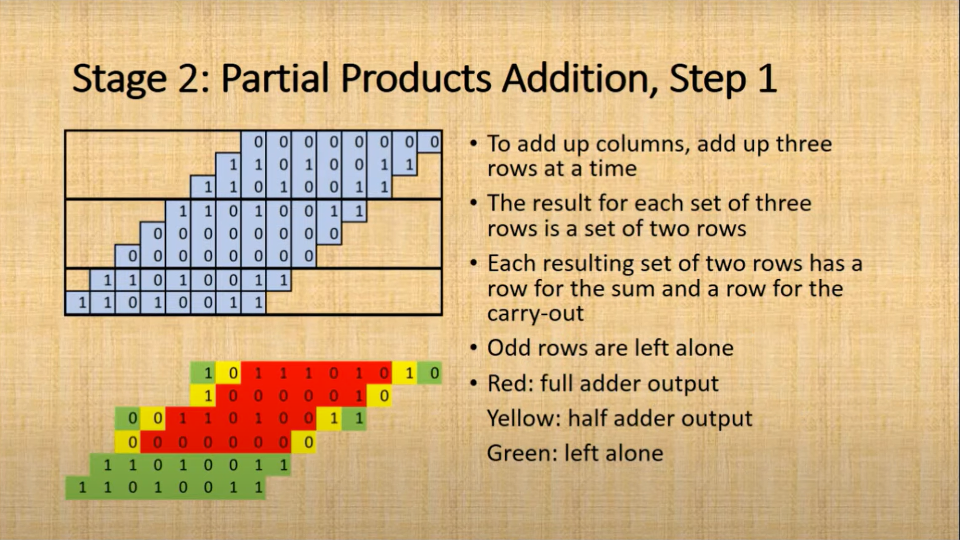

Slide 5
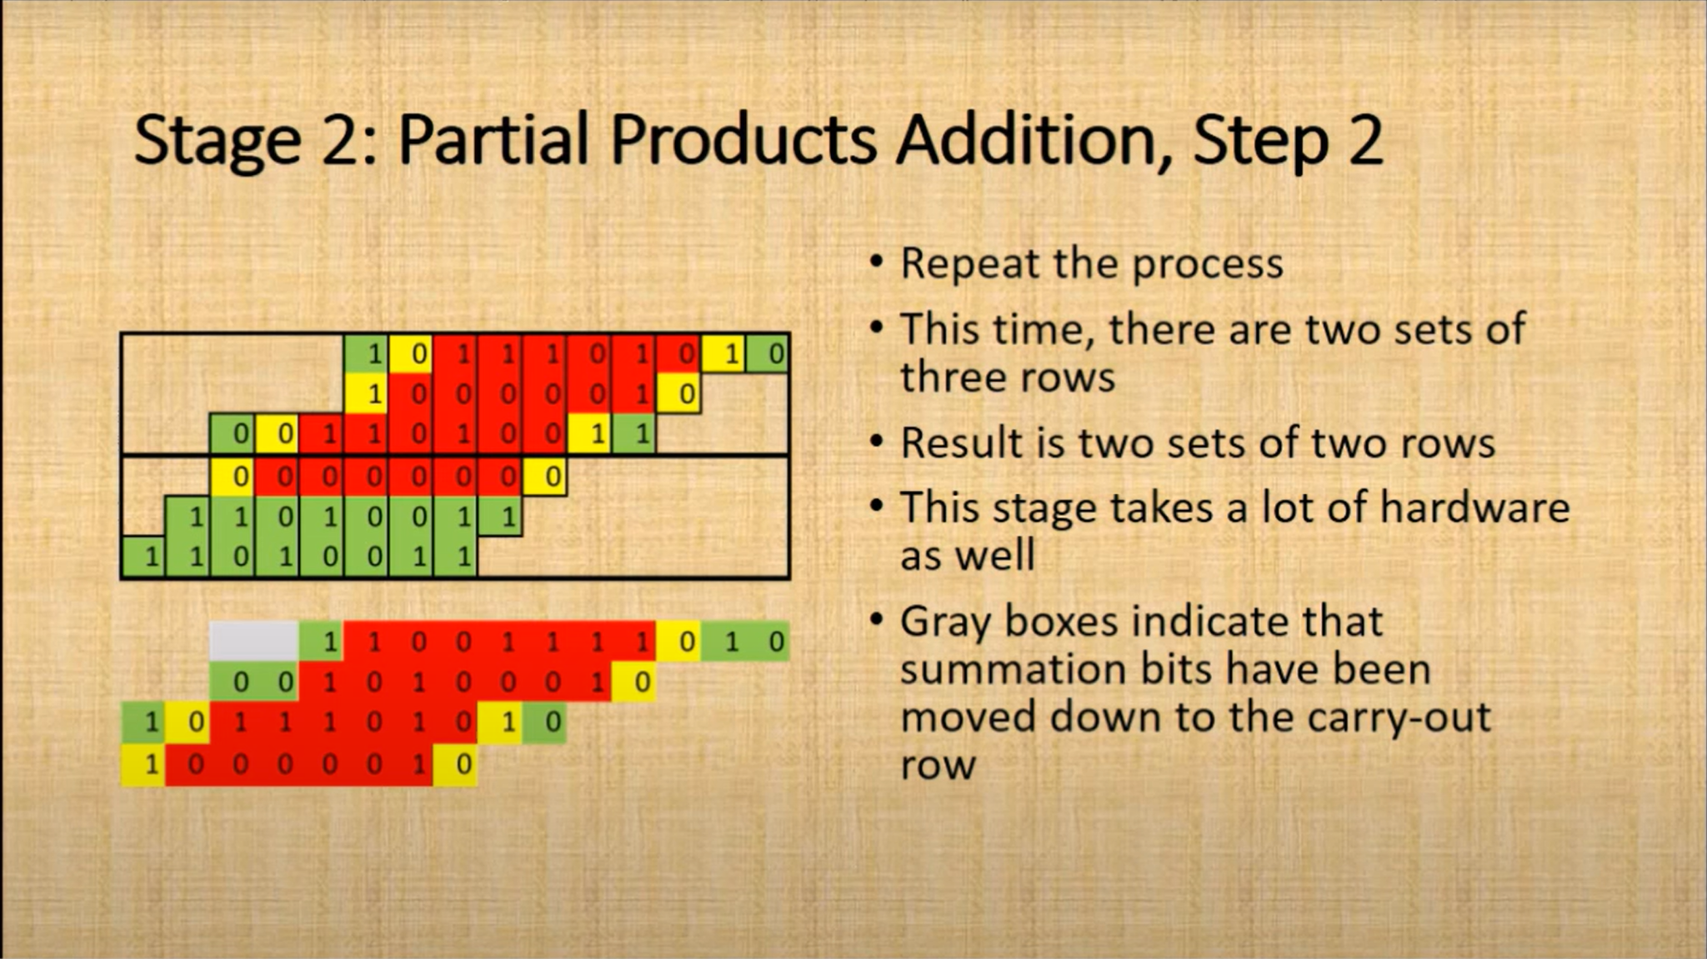

Slide 6
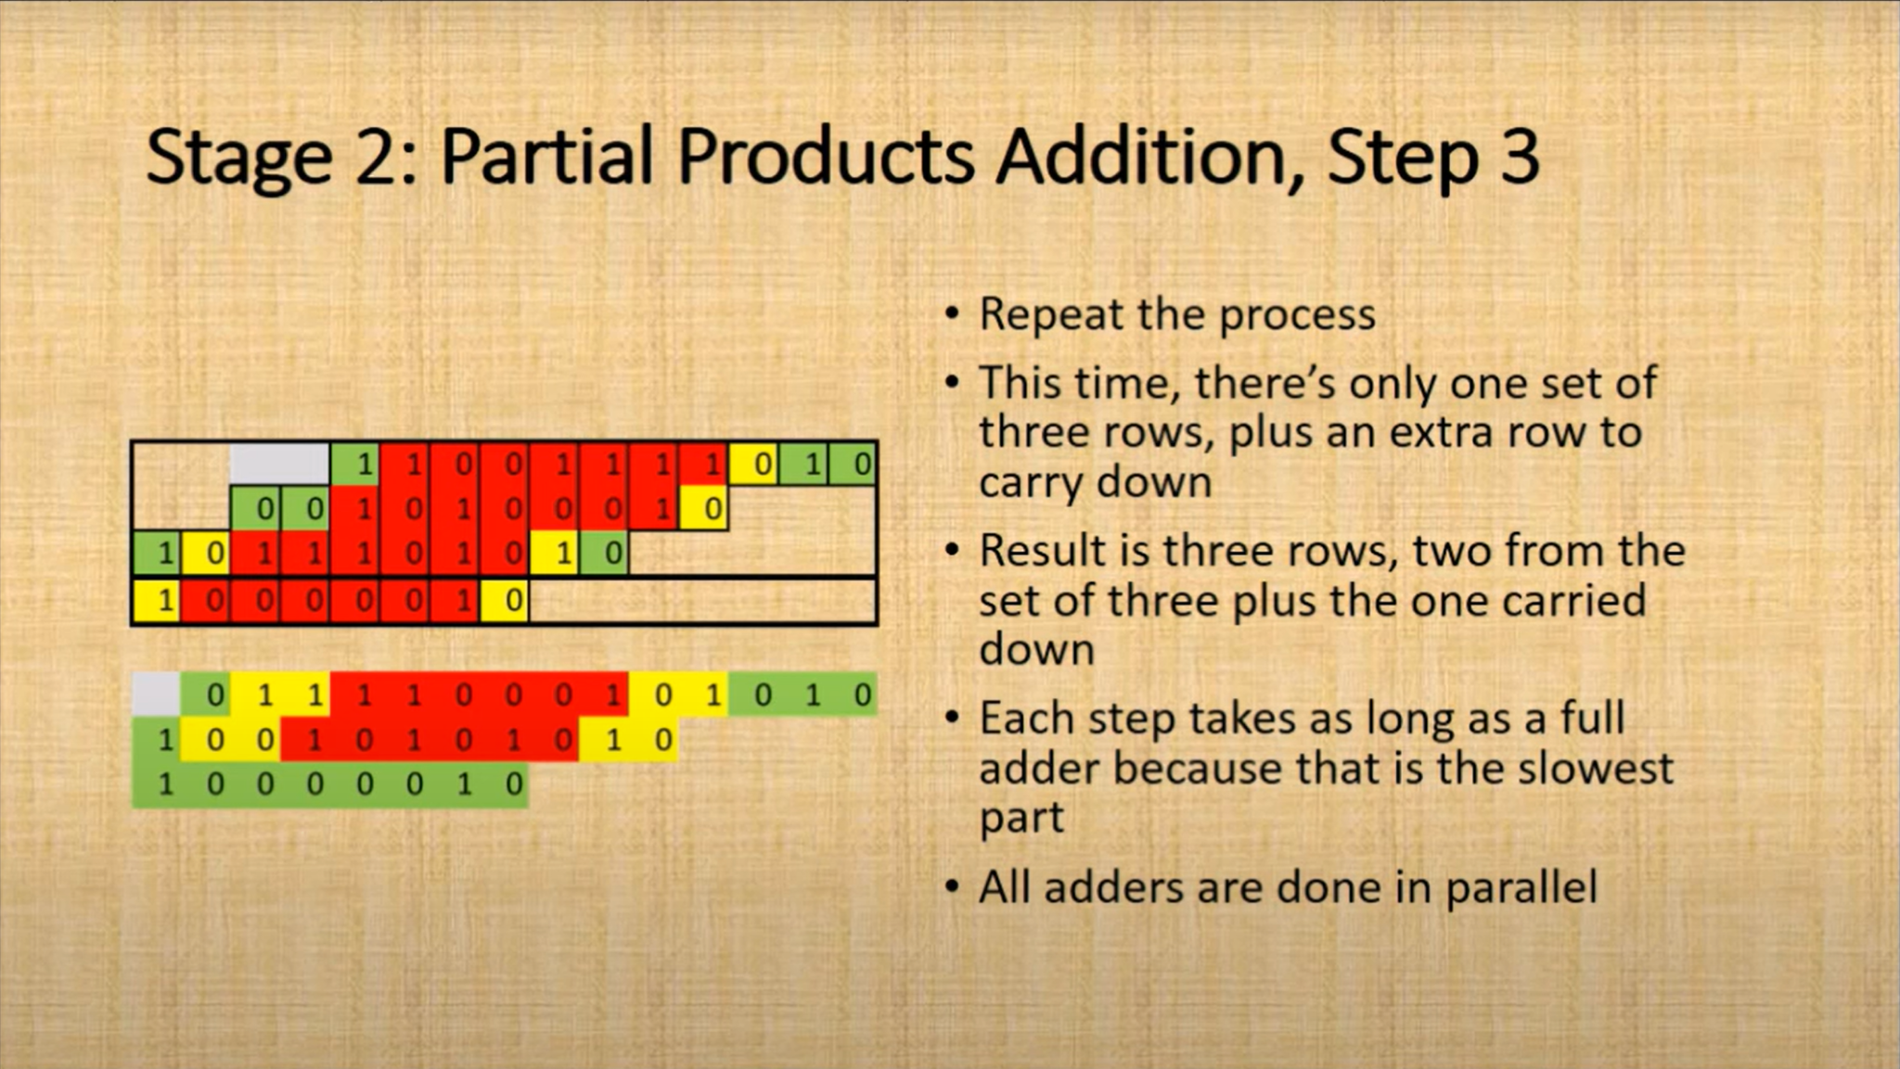

Slide 7
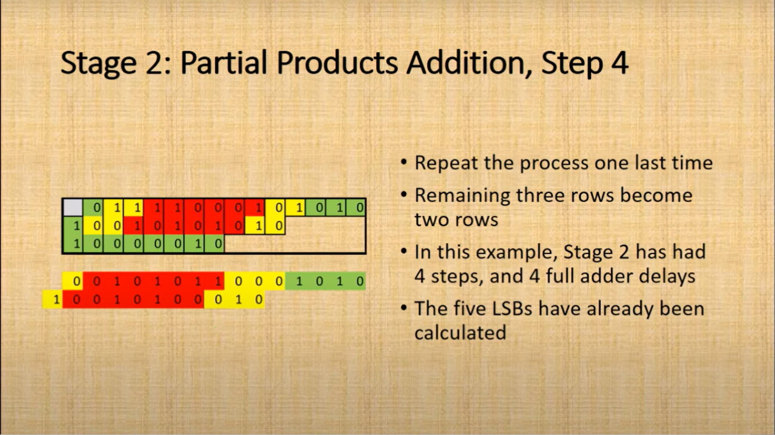

Slide 9
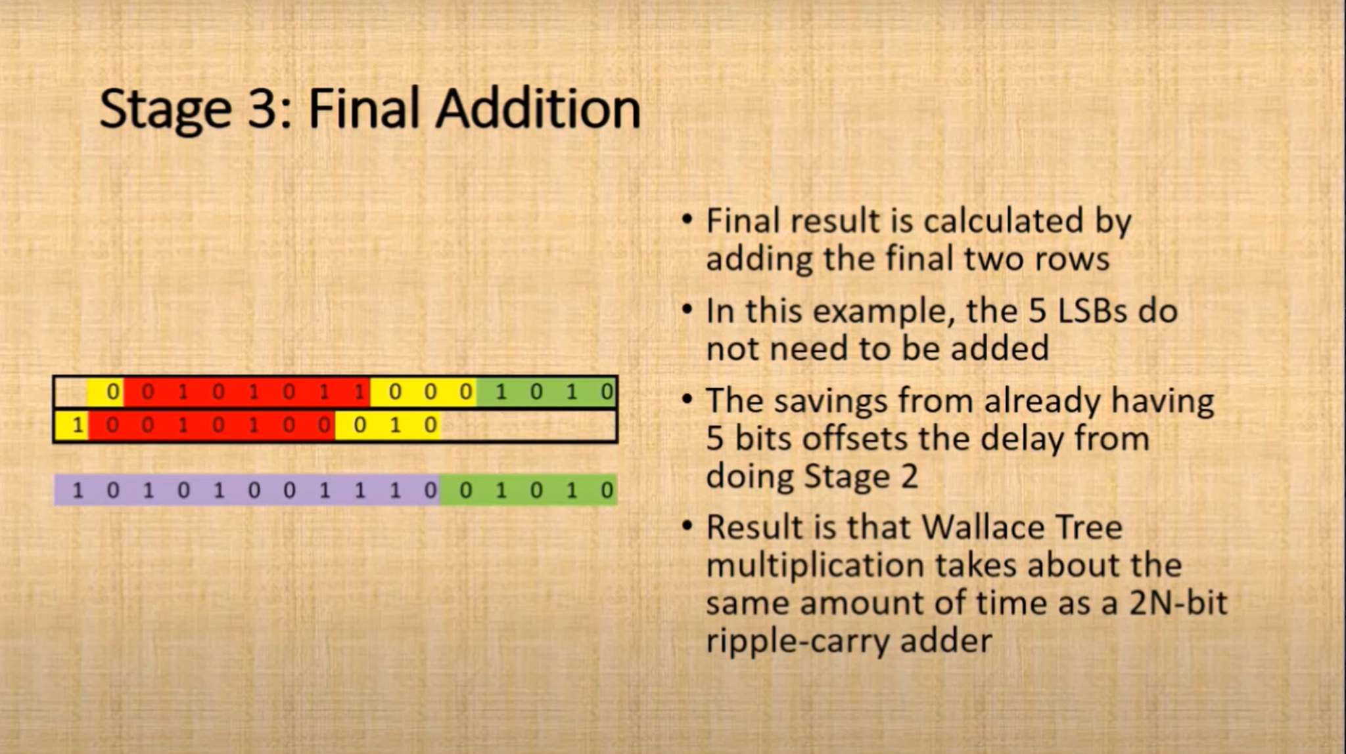

Slide 10
Kogge Stone Adder
Kogge Stone adder is very attractive for high-speed applications which come at the cost of high area and more power.
Due to its high-speed performance and low fanout, the Kogge stone adder is regarded as one of the main adders among parallel prefix adders.
Three different stages during computation:
• Pre-Processing stage:
Pi = Ai XOR Bi
Gi = Ai AND Bi
• Generation of carry:
Gi = (Pi AND Gi-1) + Gi
Pi = (Pi AND Pi-1)
• Final processing stage:
Ci = Gi Si = Pi XOR Ci-1

Slide 11
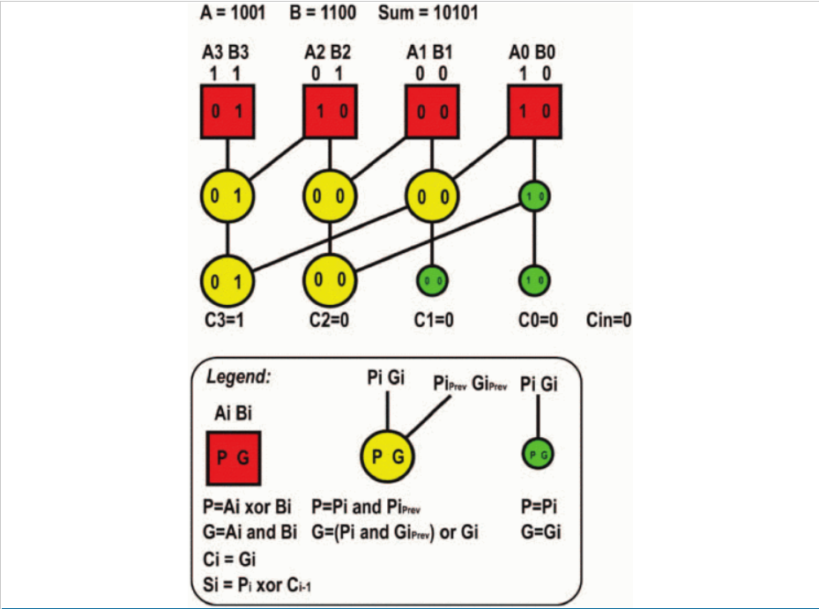
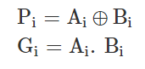
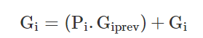
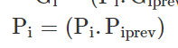
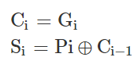
EXAMPLE
Steps:
1.
2.
3.

Slide 12
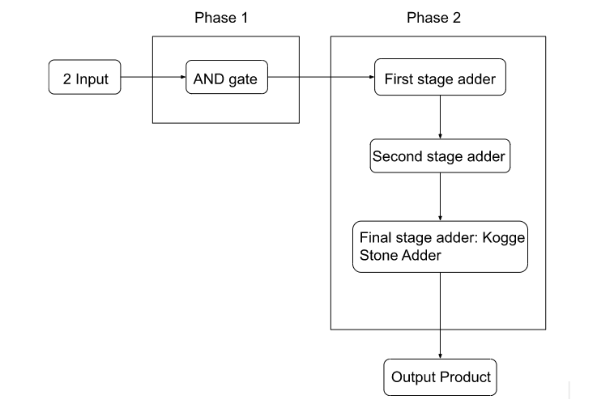
Wallace tree multiplier using Kogge Stone Adder

Slide 13
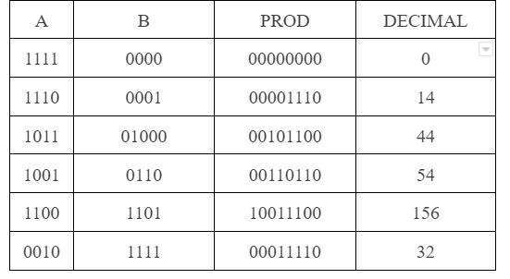
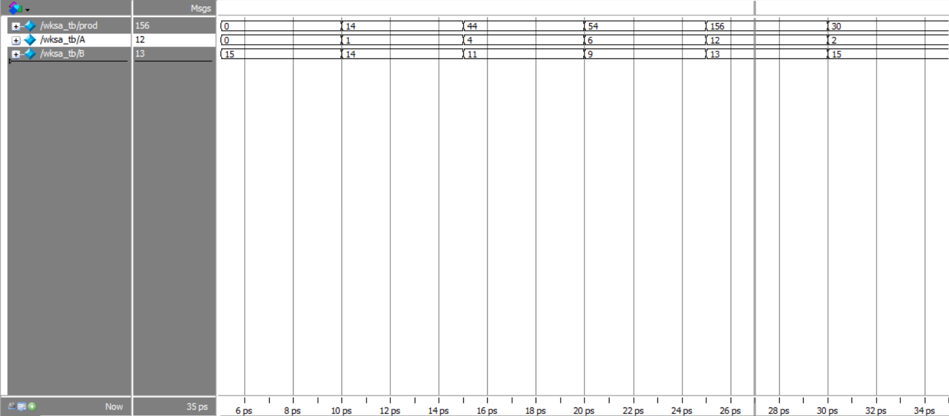
Results:

Slide 14
Reference:
[1] Y. d. Ykuntam, K. Pavani and K. Saladi, "Design and analysis of High speed wallace tree multiplier using parallel prefix adders for VLSI circuit designs," 2020 11th International Conference on Computing, Communication and Networking Technologies (ICCCNT), 2020, pp. 1-6, doi: 10.1109/ICCCNT49239.2020.9225404.
[2] G. C. Geethanjali, P. D. Prathima, G. M. Preethi, R. Likitha, and B. B. Manjula, “Implementation and Analysis of Wallace Tree Multiplier Using Kogge Stone Adder and Sklansky Adder”, IJRESM, vol. 5, no. 6, pp. 45–49, Jun. 2022.
[3] Raghumanohar Adusumilli and Vinod Kumar K, “Design and Implementation of a high speed 64 bit Kogge-Stone adder using Verilog HDL”, Int. Journal of Electrical and Electronic Engineering & Telecommunications, Vol.3, No.1, pp 13 – 18, 2014.
[4] A. Sundhar, S. D. Tharshini, G. Priyanka, S. Ragul and C. Saranya, "Performance Analysis of Wallace Tree Multiplier with Kogge Stone Adder using 15-4 Compressor," 2019 International Conference on Communication and Signal Processing (ICCSP), 2019, pp. 0903-0907, doi: 10.1109/ICCSP.2019.8697981.
[5] N. Kumar M., R. S. Adithyaa, B. Kumar D. and T. Pavithra, "Design Analysis of Wallace Tree based Multiplier using Approximate Full Adder and Kogge Stone Adder," 2020 6th International Conference on Advanced Computing and Communication Systems (ICACCS), 2020, pp. 612-616, doi: 10.1109/ICACCS48705.2020.9074336.

